Slide 1
Uplifting the Farmer through a Connected Ecosystem
PIP2001 Capstone Project
Review-0
Batch Number: 39
Under the Supervision of,
Mr. Amarnath J.L
Assistant Professor
School of Computer Science and Engineering
Presidency University
Roll Number | Student Name
20211CSE0241 | G K Raghavendra Rao
20211CSE0243 | Bharath B Nagilla
20211CSE0246 | Jayanth D
20211CSE0336 | S Kushal
Name of the Program: CSE
Name of the HoD: Dr. Blessed Prince P/Dr. Robin Rohit/Dr.Asif Mohammed H.B
Name of the Program Project Coordinator: Mr. Amarnath J.L & Dr. Jayanthi. K.
Name of the School Project Coordinators: Dr. Sampath A K / Dr. Abdul Khadar A / Mr. Md Ziaur Rahman

Slide 2
Content
Problem Statement
Github Link
Analysis of Problem Statement
Timeline of the Project
References

Slide 3
Problem Statement Number: PSCS59
Organization: Mahindra&Mahindra(FarmEq)
Category (Hardware / Software / Both) : Software
Problem Description : How can a farmer gain access to all the elements of his farming cycle?one stop shop where he has access to information from different aggregators, for retailing , leasing & finally taking his produce to the nearest mandi. Application to provide a means of easy transaction for all his farming activities and his personal expenses. Agri credit should help him buy/lease Farm Machinery & have access to all the local vendors for his plantation needs including expert advice from the local university
Difficulty Level: Complex

Slide 4
Github Link
The Github link provided should have public access permission.
https://github.com/Bharathnags/UPLIFTING-THE-FARMER-THROUGH-CONNECTED-ECOSYSTEMS

Slide 5
Analysis of Problem Statement
Technology Stack Components:
Java for native Android development
MongoDB for unstructured data or flexible storage needs, like user-generated content, weather data, or multimedia content.
Payment Gateway APIs:Stripe, PayPal, or Razorpay for enabling secure online transactions
OAuth 2.0 and JWT (JSON Web Tokens) for secure authentication
Unit Testing

Slide 6
Analysis of Problem Statement (contd...)
Software Requirements:
User Management and Authentication
Crop Advisory
Communication and Networking
Data Analytics and Reports

Slide 7
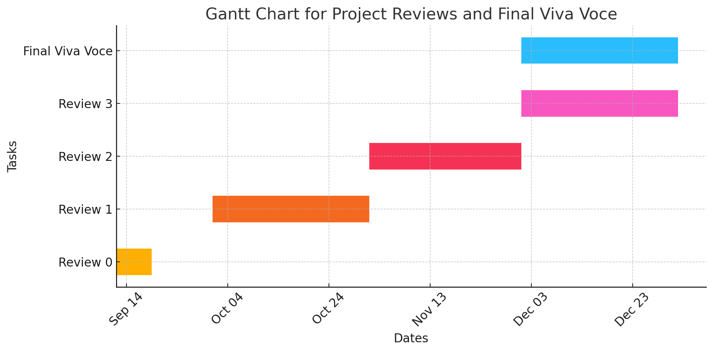
Timeline of the Project (Gantt Chart)

Slide 8
References (IEEE Paper format)
M. Masinde and P. N. Thothela, "ITIKI Plus: A Mobile Based Application for Integrating Indigenous Knowledge and Scientific Agro-Climate Decision Support for Africa’s Small-Scale Farmers," 2019 IEEE 2nd International Conference on Information and Computer Technologies (ICICT), Kahului, HI, USA, 2019, pp. 303-309, doi: 10.1109/INFOCT.2019.8711059. keywords: {Agriculture;Meteorology;Production;Tools;Decision support systems;Investment;Mobile handsets;ITIKI plus;indigenous knowledge;drought prediction;cropping decisions;small scale farmers;Kenya;Mozambique;South Africa},
J. Jayachitra, M. Madhu and S. D. S. Mohammed Faruk, "AGRI SUCCOR: Mobile Application for Agriculture," 2019 International Conference on Communication and Electronics Systems (ICCES), Coimbatore, India, 2019, pp. 921-924, doi: 10.1109/ICCES45898.2019.9002077. keywords: {Agriculture;Diseases;Conferences;Mobile applications;Meteorology;Tools;Feature extraction;Farmers;Agri Succor;crop disease identification;mobile application},
N. Nojozi, M. S. Scott and P. Nomnga, "An m-agric application for broadcasting agricultural information for subsistence farmers in rural areas of the eastern cape," 2016 IST-Africa Week Conference, Durban, South Africa, 2016, pp. 1-8, doi: 10.1109/ISTAFRICA.2016.7530645. keywords: {Mobile applications;Agriculture;Databases;Smart phones;Androids;Humanoid robots;MobileApplication;Rural Subsistence Farmers;Agriculture Information},
D. S. Gangwar, S. Tyagi and S. K. Soni, "Connecting Farmers to Knowledge, Networks and Institutions for Agroecological Sustainability," 2020 International Conference on Electrical and Electronics Engineering (ICE3), Gorakhpur, India, 2020, pp. 311-315, doi: 10.1109/ICE348803.2020.9122983. keywords: {Digital agriculture services;Precision farming;Community education;Socio-economic wellbeing;Environmental footprints},

Slide 9


